Slide 1

Explore India: Heritage Preservation Platform
A digital platform preserving & promoting Indian heritage.
Team: supe_slayers
Team Members Names: Srakshin Chityala, Jashwanth Mareddy
Domain: Creative tech
College: GRIET.

Slide 2

Technological Advancements: Frontend & Backend
Discover the cutting-edge technologies powering our platform. From frontend design with HTML, CSS, JS, Nodejs and React to backend development using Flask, Python, and APIs, we ensure a seamless and innovative user experience.

Slide 3

Challenge: Explore India's Rich Heritage
Problem
Our Goal
How to help foreigners explore India's heritage interactively and in a creative way?
Learn about culture
Plan travel easily
Shop for crafts
Interact in languages
Street views of popular places
Traditional events popup

Slide 4






Solution: A Responsive Heritage Website
Heritage-themed design
Interactive map
Itinerary generator
Online shop

Slide 5




Tech Stack for a Seamless Experience
Frontend
React, HTML, CSS, JavaScript,
Backend
Python Flask
APIs
Gemini, Olomo, OpenAI, gTTS

Slide 6
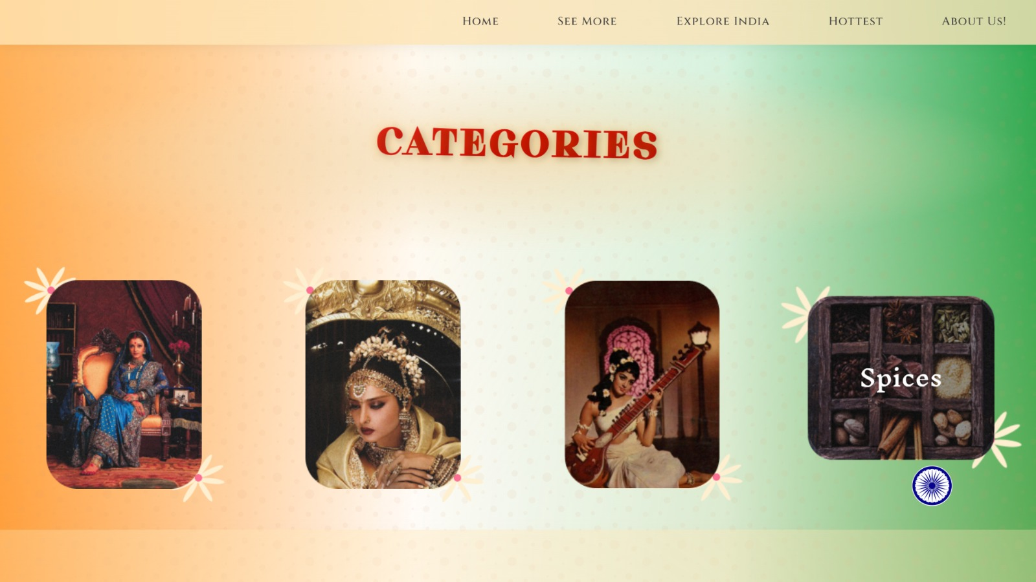


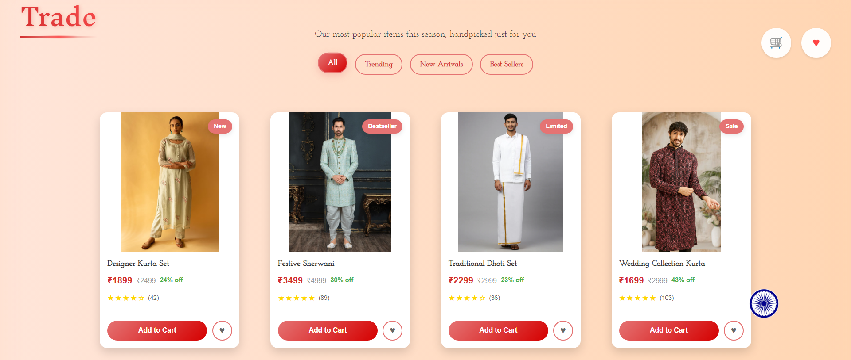


Key Website Features
Explore Page
Clickable states, places, culture
Shopping Page
Dresses, jewelry, state filters
AI Chatbot
Gemini-powered culture guide
Itinerary Gen
Personalized plans, budget based

Slide 7
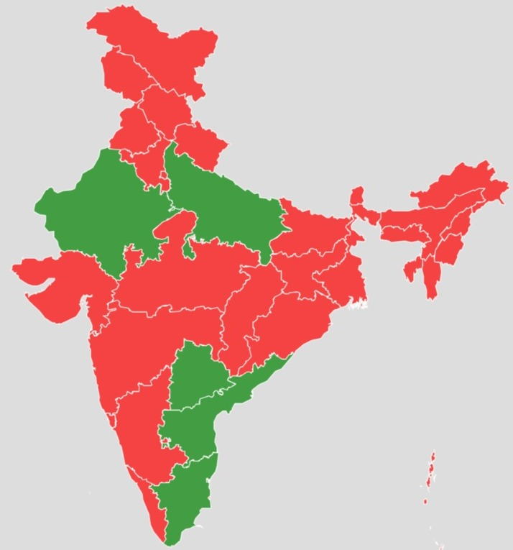
Design Highlights: Elegant & Animated
Indian colors
Circular nav bar
Animated transitions
Clean CSS

Slide 8






Free Software’s Used
Github
Gemini 1.5 flash
Gemini pro
Ollama
Bootstrap
Unsplash
GTTs
FDFP

Slide 9
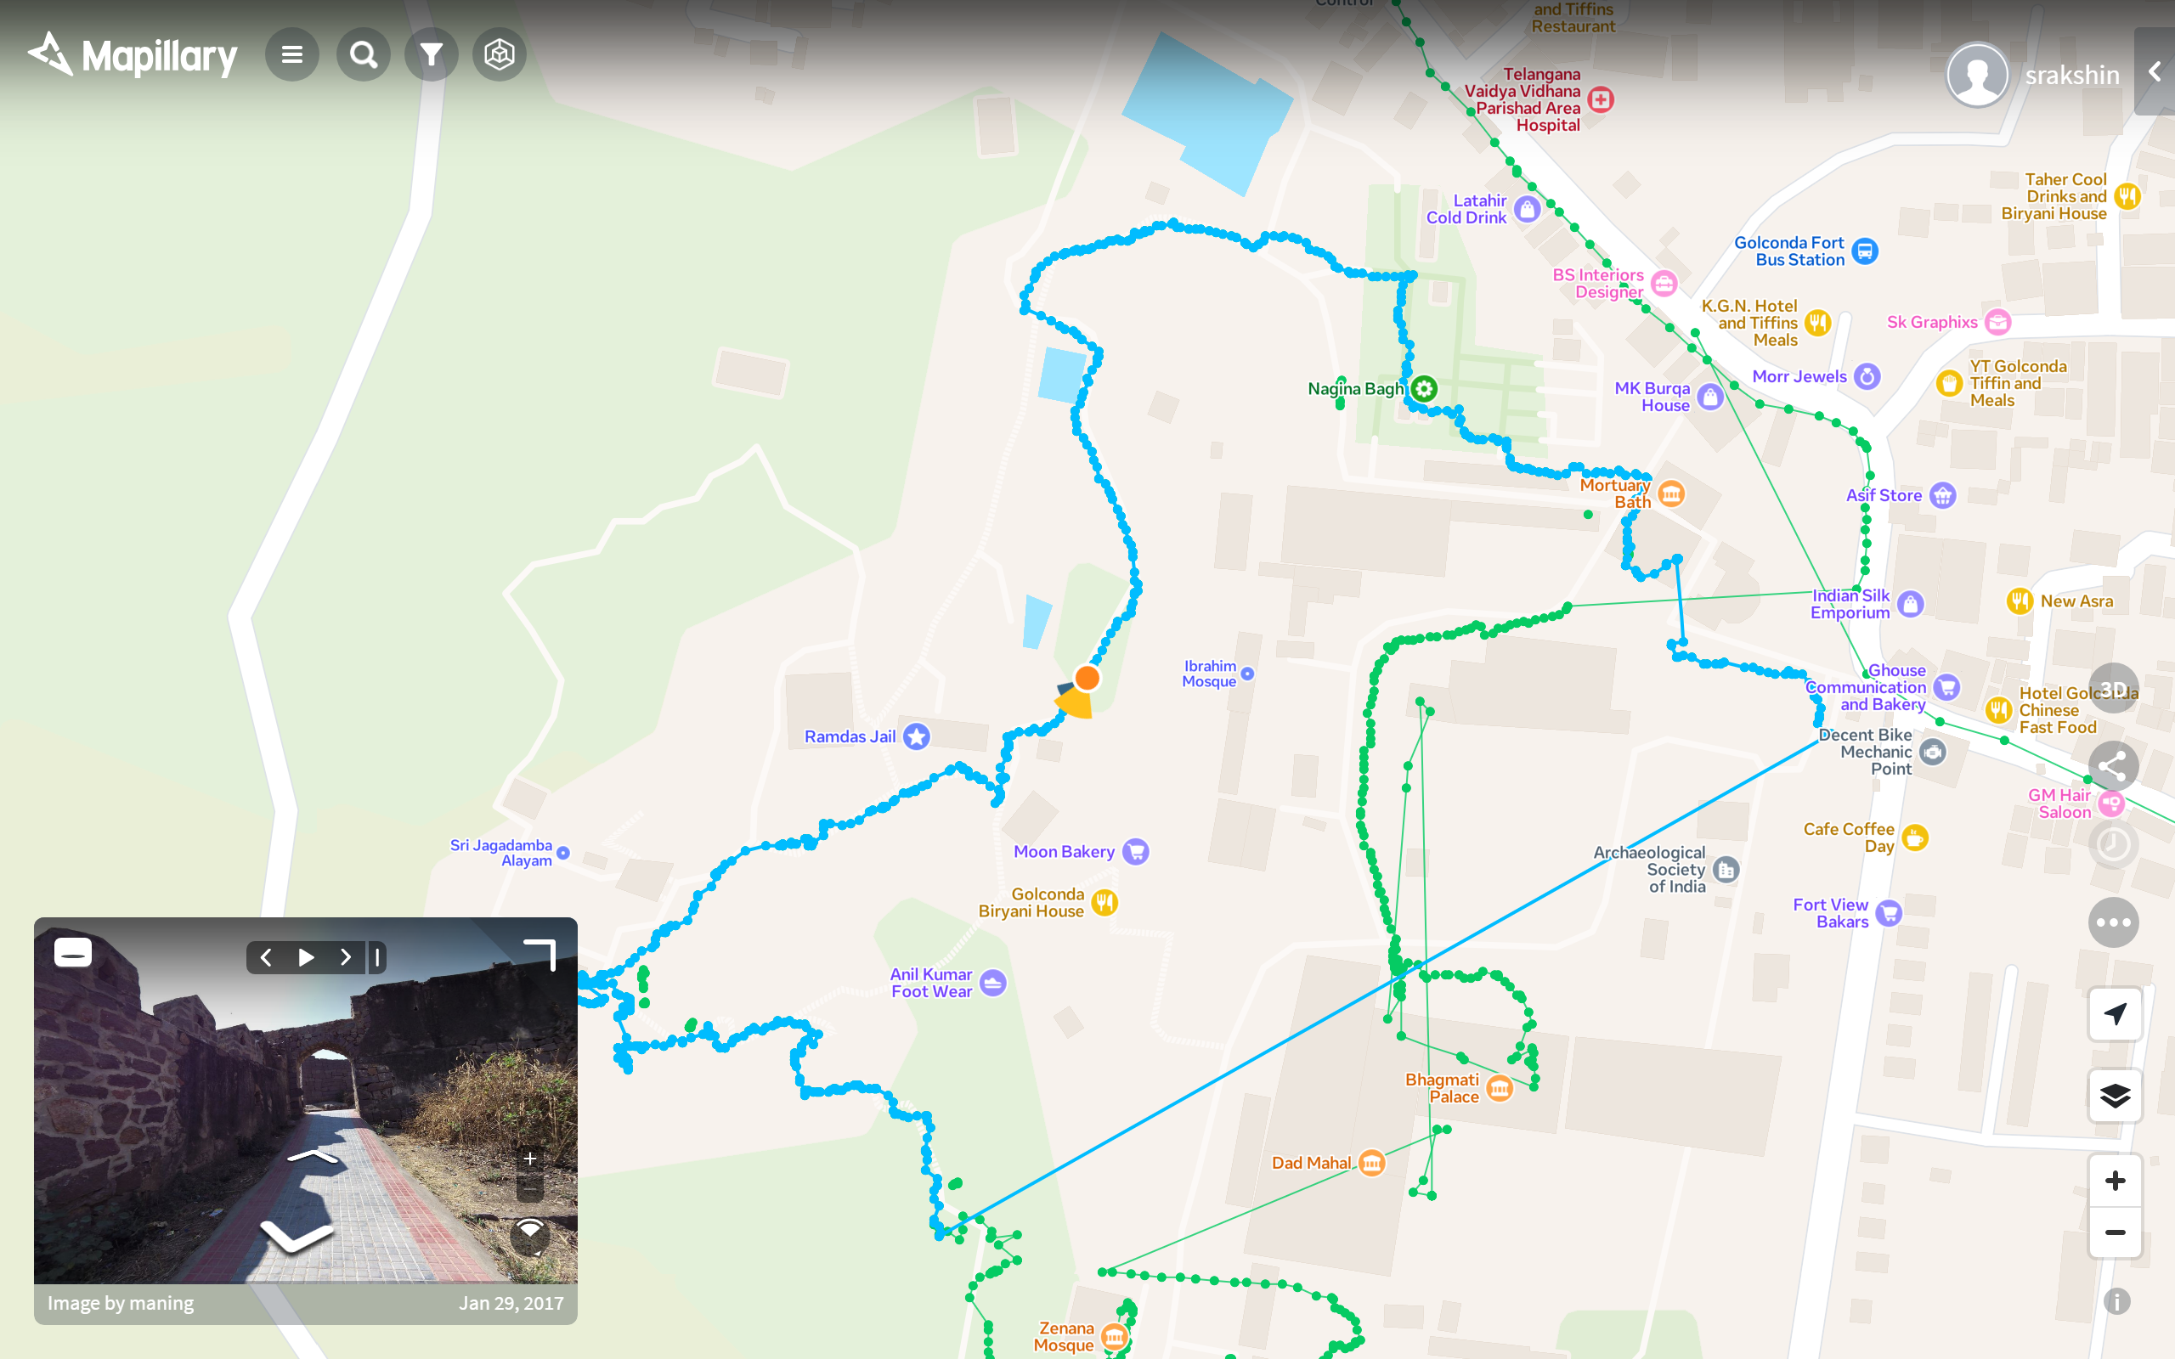
Innovation & Uniqueness
Street viewer
Real-time Speech
Visiting virtually
22 Indian languages
AI Chatbot
Bharat yatra
Easy Exploration
Personalized

Slide 10
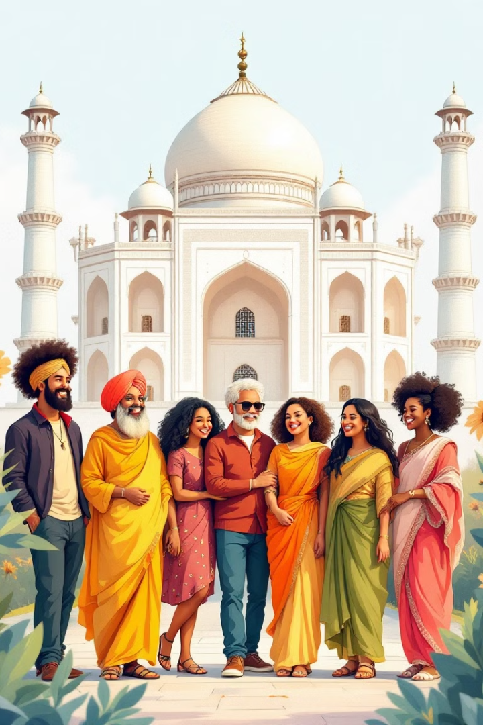
Thanks for Exploring with Us!
We hope you have enjoyed discovering India's rich heritage.
Visit again for new features and cultural insights.

